Slide 1
OPTIMIZING BANK MARKETING USING MACHINE LEARNING AND PREDICTIVE MODELS
Authors :
AA
ABHAY RATHORE
SNEHA KASHYAP
2205697
2205596
VAIBHAV PODDAR
2205601

Slide 2
Abstract :
In particular, they put to the test all the machine learning methods able to gauge customer attitudinal responses to various marketing campaigns. More specifically, LightGBM showed the best accuracy result of (90.66%), succeeded by Random Forest and SVM with (89.33%), Gradient Boosting, and another Adaboost with (89.38%), Logistic Regression with (90.15%), XGBoost (90.54%), and Decision Tree with (87.44%), and finally Naive Bayes with (85.08%). This dataset includes some level of preprocessing to handle missing data, encoding categorical variables, and carry out feature engineering most likely to improve model performance. In terms of metrics for evaluation, accuracy and precision, recall, and F1 score were analyzed. The results conclude that ensemble models, particularly Random Forest and Gradient Boosting, produce the best performance overall.
KEYWORDS: Machine Learning, Bank Marketing, Customer Response Prediction, Random Forest, Gradient Boosting, XGBoost, Logistic Regression, Predictive Analytics, Customer Segmentation, Feature Engineering, Model Evaluation, Targeted Marketing, Financial Data Analysis, Real-Time Prediction, Deep Learning, Hybrid Models, Decision-Making, Banking Industry

Slide 3
INTRODUCTION
Over the years, the banking sector has significantly changed due to data-driven decision making, especially in bank marketing, where analytical help with customer response prediction regarding campaigns. Many financial institutions want to boost customer interaction and make marketing efforts more effective. Machine learning models and statistical techniques are highly effective tools for analyzing vast amounts of customer data and gaining meaningful insights that could guide outreach efforts. The aim of this study is to analyze a bank-marketing dataset for predictive models for estimating customer likelihood for term-deposit subscription within. The dataset includes customer demographics, previous campaign interactions, and economic indicators. Machine learning algorithms like Random Forest, Gradient Boosting, and Logistic Regression will be applied to be able to make accurate predictions, thus enhancing customer targeting. The banking sector marketing campaigns have long been resource intensive activities; so much has been invested, but still, a good number of campaigns do not yield desired results due to, among other things, ineffective targeting strategies. By implementing machine-learning techniques and exploratory data analysis, banking institutions will be able to unearth insights into consumer preferences, trends around engagement with campaigns, and the factors that drive conversion rates.

Slide 4
Data Preprocessing
Handled missing values to ensure data consistency.
Encoded categorical variables into numerical form for ML models.
Checked for duplicate records to avoid bias in the model.
Used a correlation heatmap to detect multicollinearity between features.
Used Box Plots to visually detect outliers.
Removed outliers using the IQR method for cleaner data.

Slide 5
Basic Concepts
Extra Trees Classifier
Bagging Classifier
Stacking
Type: Ensemble (combines multiple models).
Pros: Improves prediction accuracy by leveraging the strengths of different models, robust to overfitting.
Cons: Computationally intensive, complex to implement and interpret.
Loan Use Case: Enhancing prediction accuracy for loan approvals by combining multiple model outputs.
.
Type: Tree-based.
Pros: Reduces overfitting, parallelizable, handles noisy data.
Cons: Slightly lower accuracy than boosted models (e.g., LightGBM).
Loan Use Case: Robust risk assessment with moderate interpretability.
Type: Ensemble.
Pros: reduces variance, stable.
Cons: Computationally intensive, less interpretable.
Loan Use Case: Improving prediction stability in loan approvals.
02
03
01

Slide 6
Basic Concepts
LightGBM Classifier
Stacking Classifier
XGBOOST
Type: Gradient Boosting (Ensemble).
Pros: High accuracy, handles missing data well, less prone to overfitting, fast training.
Cons: Requires careful tuning of hyperparameters, can be computationally intensive for large datasets.
Loan Use Case: Predicting loan default risks with high accuracy and handling imbalanced data effectively.
.Type: Tree-based (boosting).
Pros: Highest accuracy (90.6668%), fast, handles imbalanced data.
Cons: Prone to overfitting without tuning, black-box nature.
Loan Use Case: Best for high-accuracy default prediction.
Type: Ensemble.
Pros: Leverages diverse models for better performance.
Cons: Complex, risk of overfitting, hard to interpret.
Loan Use Case: Combining strengths of Logistic Regression + Tree-based models.
04
05
06

Slide 7
Hyperparameter Tuning Techniques
🔍 GridSearchCV
GridSearchCV exhaustively searches through all possible combinations of given hyperparameters.
It's accurate but can be time-consuming with large parameter grids.
🎲 RandomizedSearchCV
RandomizedSearchCV randomly samples a defined number of combinations from the parameter grid.
It's faster and more efficient than GridSearchCV, especially with many hyperparameters.
🧠 BayesianSearchCV
BayesianSearchCV uses probabilistic models to predict the best hyperparameters based on past evaluations.
It’s smarter and more efficient by focusing the search on promising areas of the hyperparameter space.

Slide 8
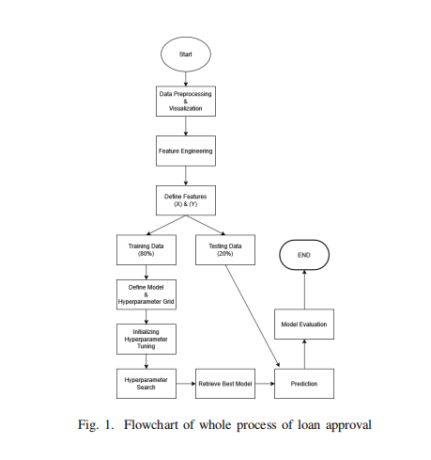
METHODOLOGY
Flowchart Overview :
1. Application Submission: Borrower provides personal/financial details.
2. Data Preprocessing: Cleaning, normalization, and feature engineering of applicant data.
3. Model Prediction: Machine learning models (e.g., LightGBM, Logistic Regression) assess default risk.
4. Decision: Approve/Reject based on risk thresholds or manual review for edge cases.

Slide 9
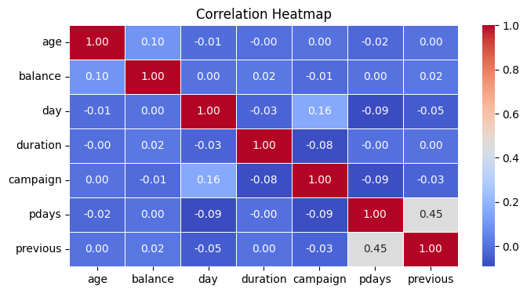
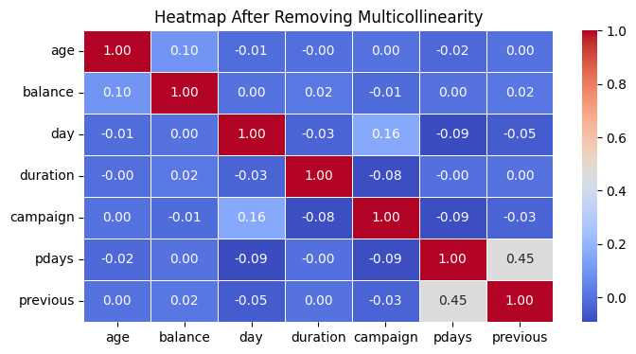
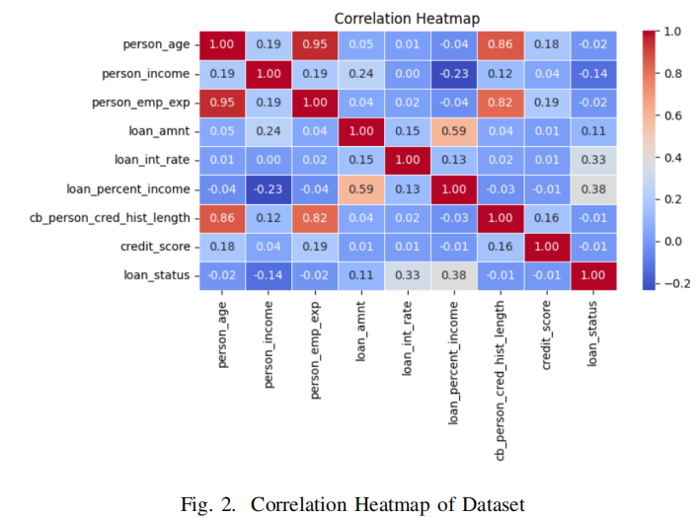
Correlation Heatmap

Slide 10
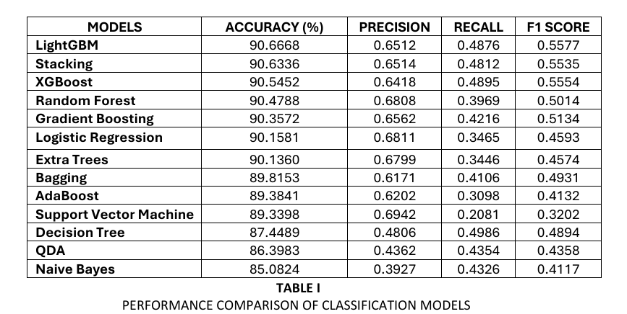
Comparison of few model
01
LightGBM outperforms
90.6668% accuracy (best overall)
0.4876 recall
Balanced precision/F1
02
Logistic Regression
90.1581% accuracy
0.3465 recall
Reduces overfitting risk
03
Decision Tree
87.4489% accuracy
Saves tuning time
Good for prototyping

Slide 11
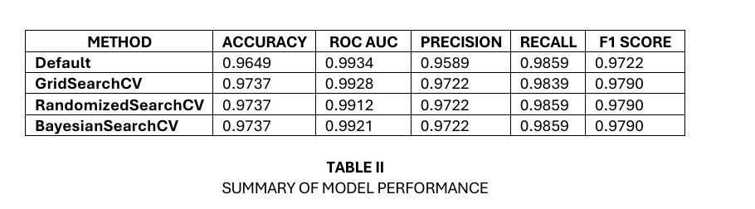
LightGBM

Slide 12
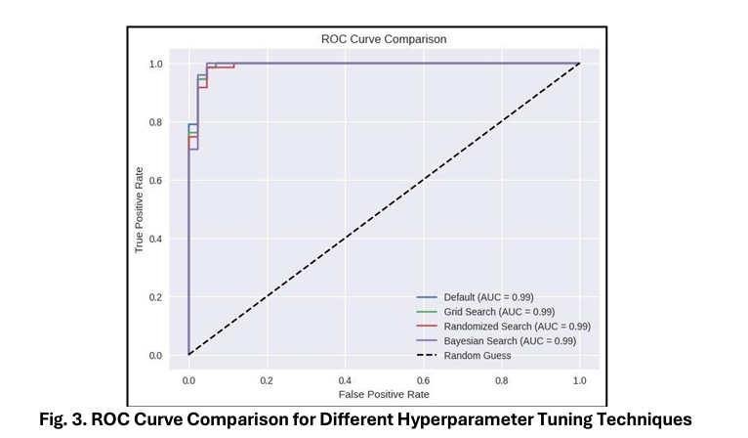
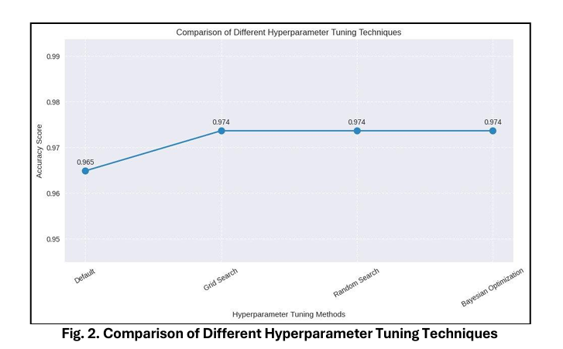
LightGBM

Slide 13
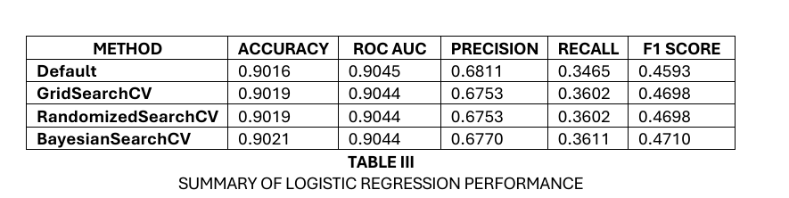
Logistic Regression

Slide 14
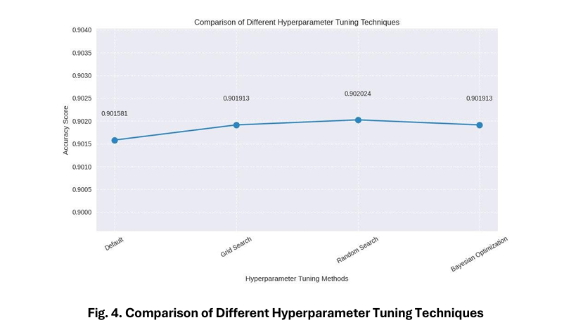
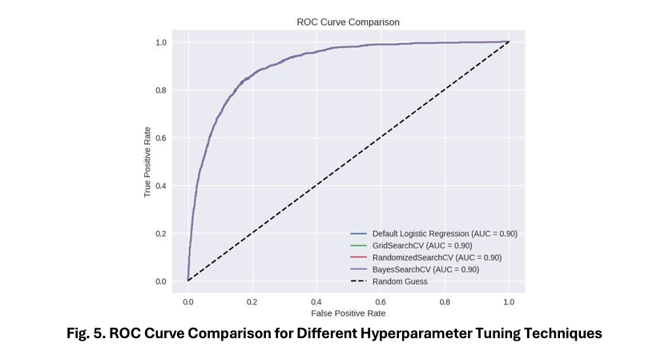

Slide 15
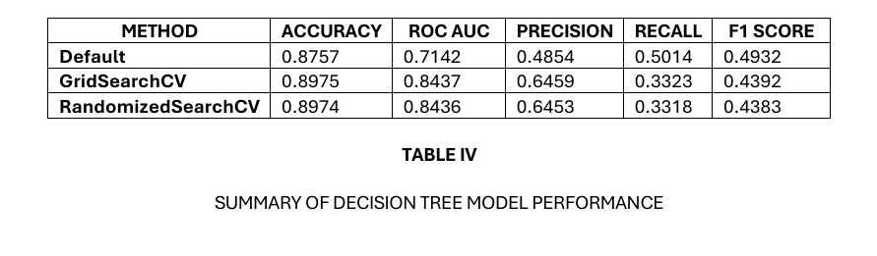
Decision Tree

Slide 16
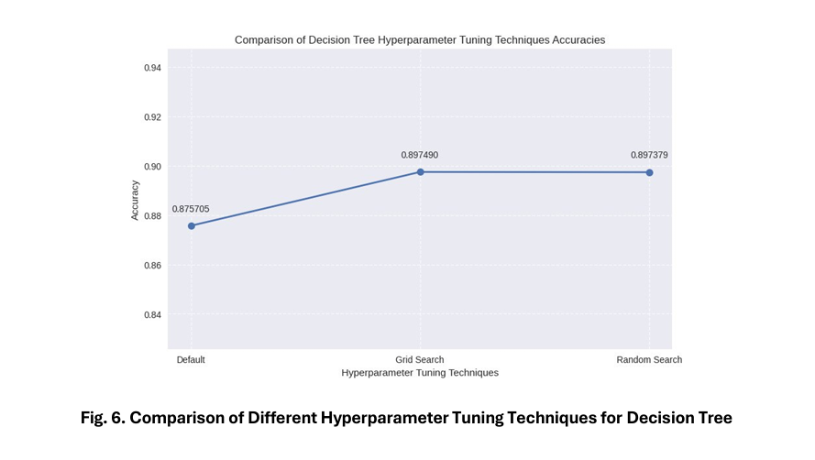
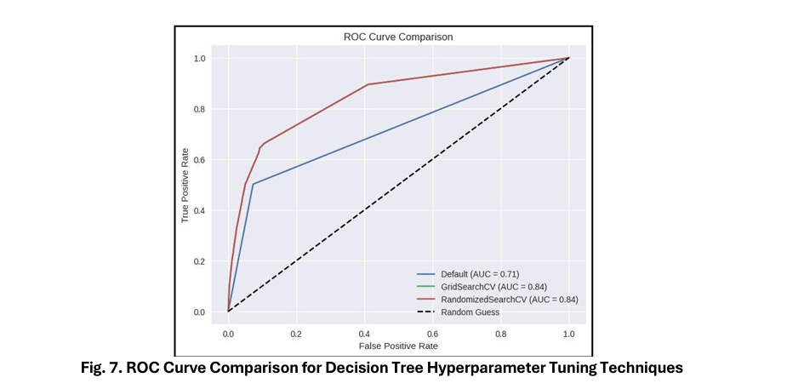

Slide 17
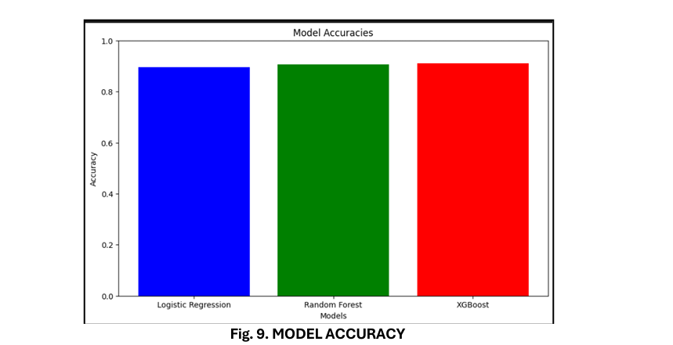
ASSESMENT OF RESULTS

Slide 18
The best hyper-parameter of different models
LightGBM
(’colsamplebytree 0.8)
(’learning rate’ 0.1) (’n estimators’ 300)
(’criterion’:’gini’)
(’maxdepth’: 5) (’minsamplessplit’: 2)
DecisionTree
‘C’:100 ’,gamma’:’penalty’:’l1’, ’solver’:’liblin’
LogisticRegression

Slide 19
CONCLUSION
Hyperparameter tuning boosts ML precision - Enhances classification accuracy for blood transfusion services.
Three optimization methods compared - GridSearch CV (most compute-heavy), random search, and Bayesian optimization all improve results.
01
02
Balance is crucial - Optimal models maintain both accuracy and generalization without over-specializing.
Customized ML needed for loans - Requires tailored approaches for different user groups and loan types.
03
04
Faster loan processing - ML enables quick, automated application evaluations.
Financial inclusion benefits - Advanced algorithms provide reliable approvals across all income levels.
05
06

Slide 20
THANK YOU

